Slide 1

IOT (INTERNET OF THINGS )

Slide 2


Slide 3

INTERNET

Slide 4

Global computer network
providing a variety of information and
communication facilities

Slide 5

Internet of Things

Slide 6
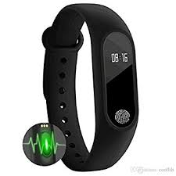
Internet of Things

Slide 7
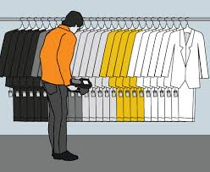
Internet of Things

Slide 8

Internet of Things

Slide 9
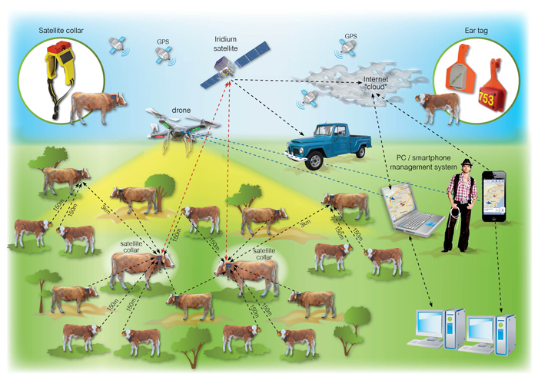
Internet of Things

Slide 10
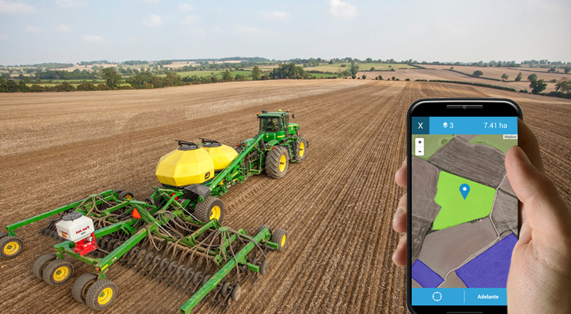
Internet of Things

Slide 11
Internet of Things
SHOPPING MALL
TOLLGATE
AGRICULTURE AND ANIMALS
Power PLANTS

Slide 12
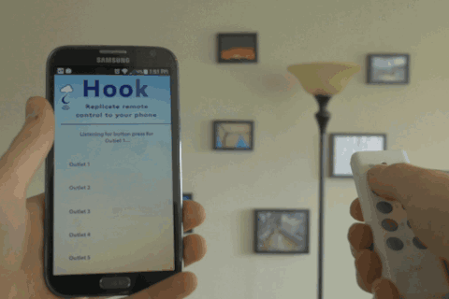
EXAMPLE

Slide 13
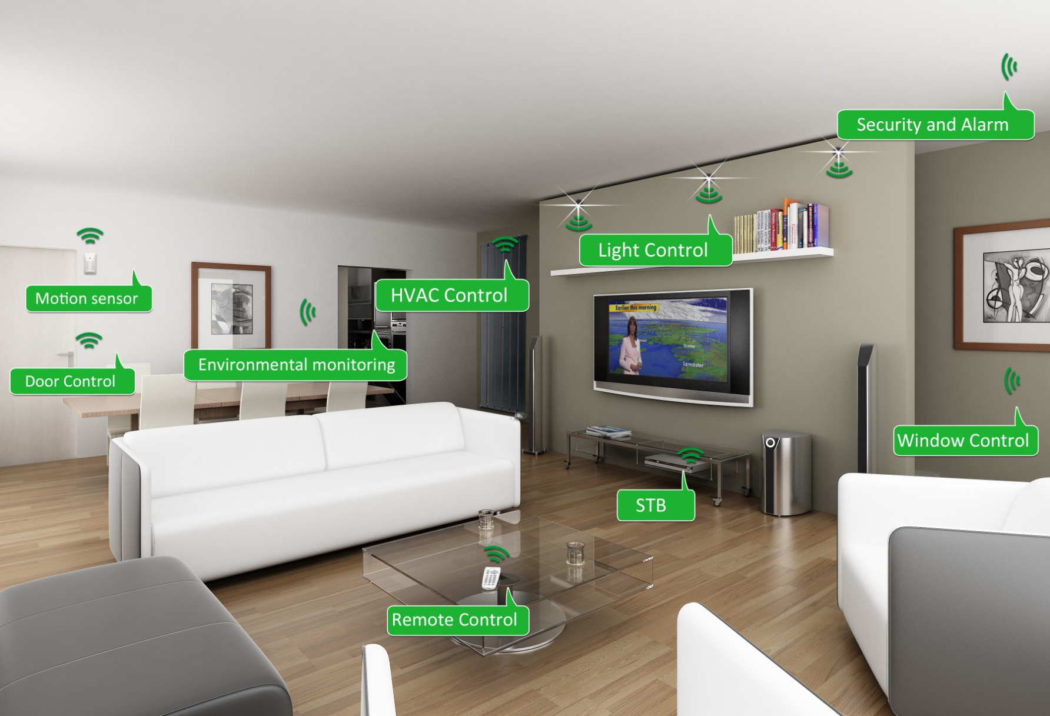
Home Automation

Slide 14
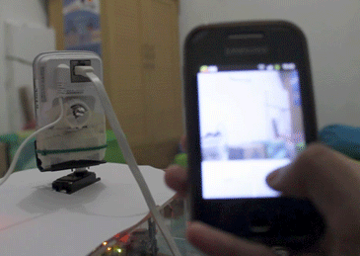
Example

Slide 15
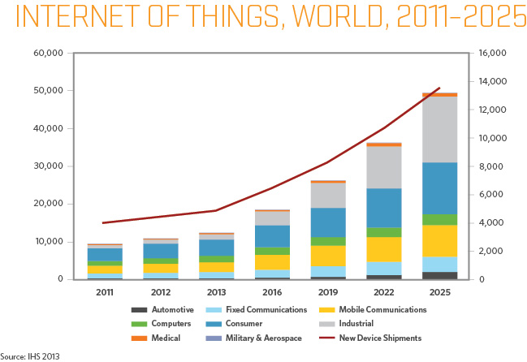
Future of IOT

Slide 16
Technologies For IOT
Short-range wireless
Medium-range wireless
Long-range wireless
Wired

Slide 17
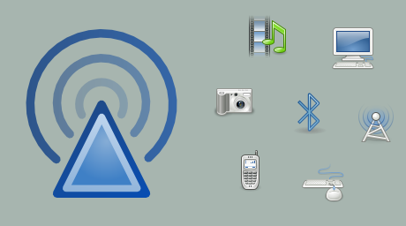
Enabling technologies for IoT
Short-range wireless
Bluetooth
NFC
Li-Fi
Wi-Fi

Slide 18
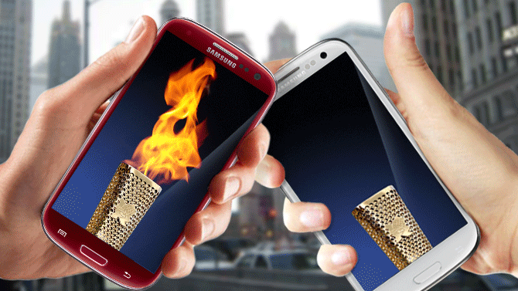
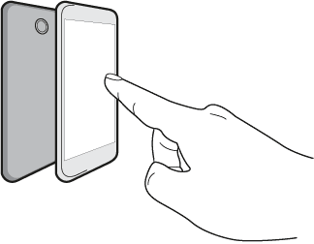
Enabling technologies for IoT
Short-range wireless
Bluetooth
NFC
Near Field Communication (4cm)
Li-Fi
Wi-Fi

Slide 19
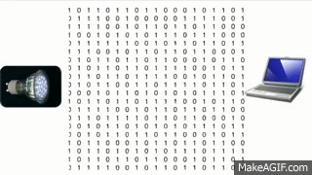
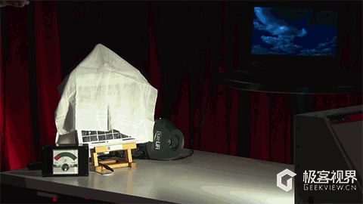
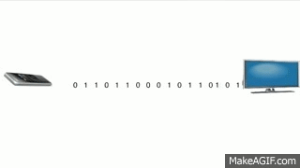
Enabling technologies for IoT
Short-range wireless
Bluetooth
NFC
Li-Fi Light fidelity
Wi-Fi

Slide 20
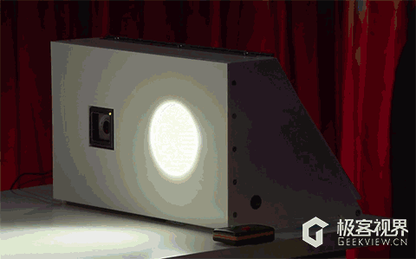
Light fidelity(Li-Fi)

Slide 21
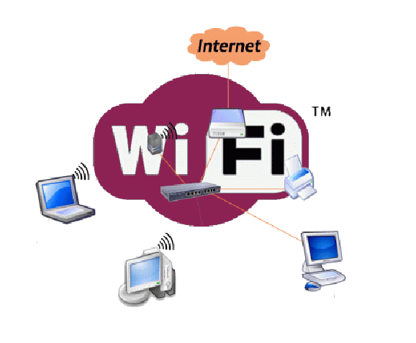
Enabling technologies for IoT
Short-range wireless
Bluetooth
NFC
Li-Fi
Wireless field(Wi-Fi)

Slide 22
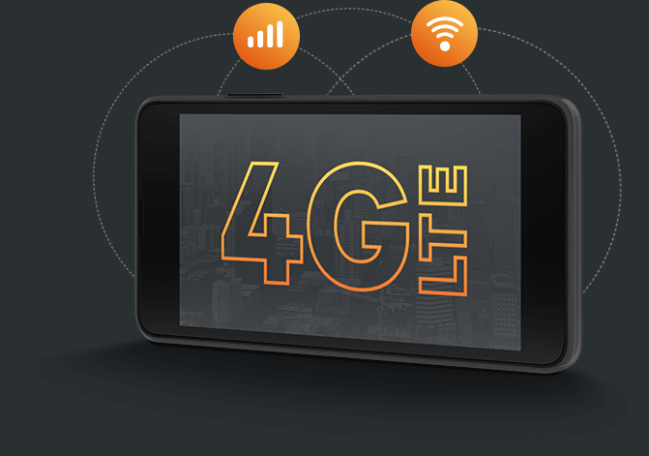
Enabling technologies for IoT
Medium-range wireless
High speed communication for mobile phones

Slide 23

Enabling technologies for IoT
Long-range wireless

Slide 24
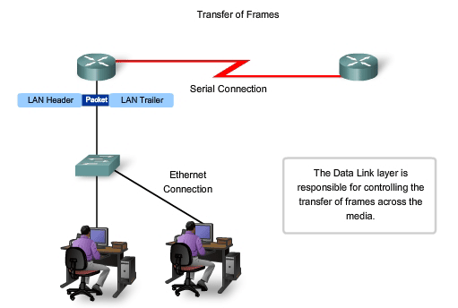
Enabling technologies for IoT
Wired

Slide 25
EMBEDDED SYSTEMS

Slide 26
Embedded Systems
COMBINATION
OF
HARDWARE + SOFTWARE

Slide 27
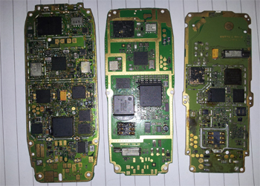
Embedded Systems
Today, Embedded Systems are found in:
Today, Embedded Systems are found in:
Cell Phones
Digital Cameras
Printers and Scanners

Slide 28
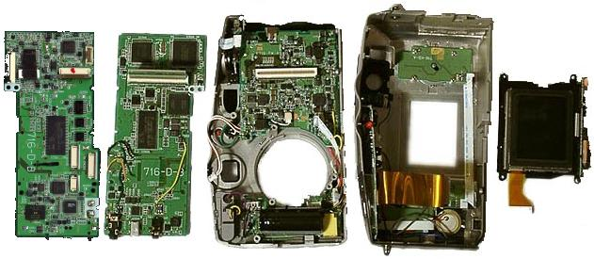
Embedded Systems
Today, Embedded Systems are found in:
Today, Embedded Systems are found in:
Cell Phones
Digital Cameras
Printers and Scanners

Slide 29
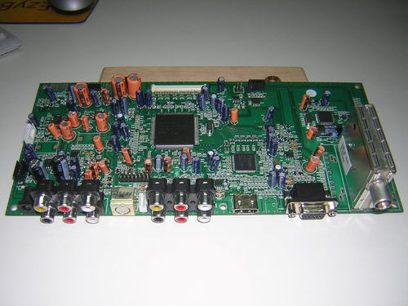
Embedded Systems
Today, Embedded Systems are found in:
Today, Embedded Systems are found in:
Cell Phones
Digital Cameras
Printers and Scanners

Slide 30
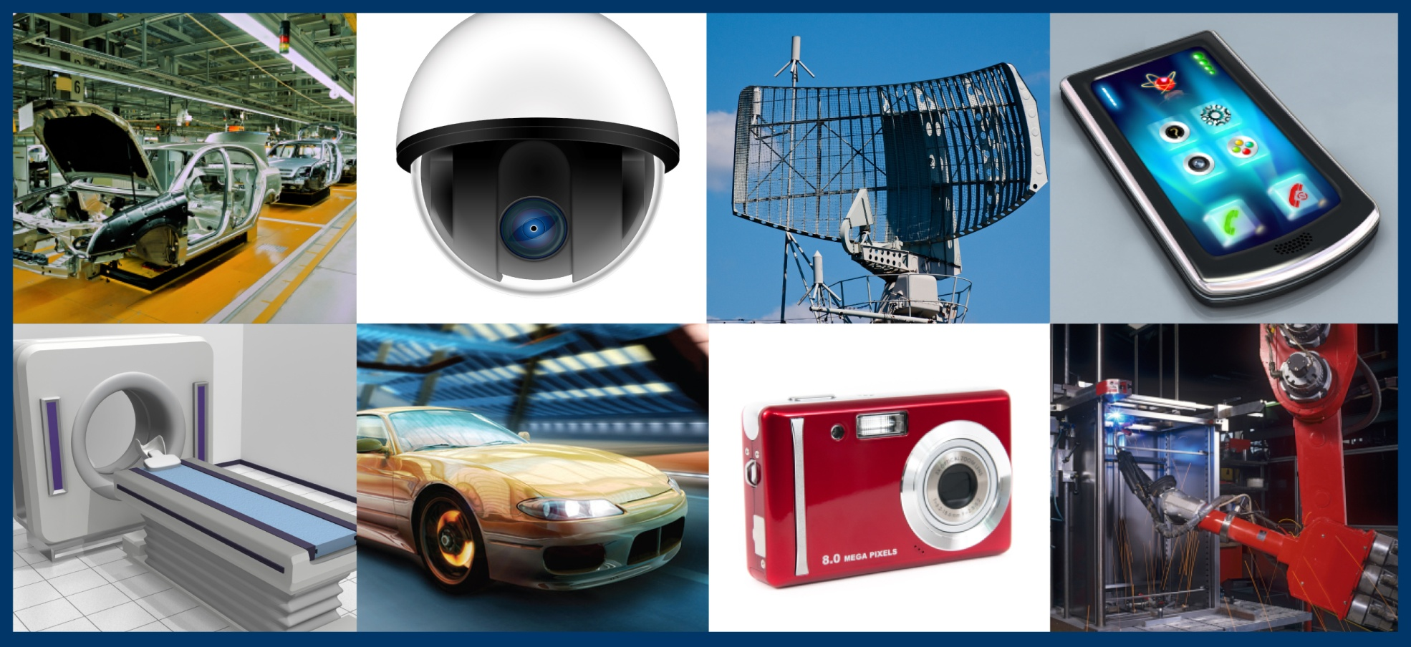
Applications of Embedded Systems

Slide 31
Embedded systems applications?
Embedded systems span all aspects of modern life and there are many examples of their use.
a) Biomedical Instrumentation – ECG Recorder, Blood cell recorder, patient monitor system
b) Communication systems – pagers, cellular phones, cable TV terminals, fax and transreceivers, video games and so on.
c) Peripheral controllers of a computer – Keyboard controller, DRAM controller, DMA controller, Printer controller, LAN controller, disk drive controller.

Slide 32
d) Industrial Instrumentation – Process controller, DC motor controller, robotic systems, CNC machine controller, close loop engine controller, industrial moisture recorder cum controller.
Scientific – digital storage system, CRT display controller, spectrum analyser.
Military & space
Agriculture
Consumer electronics

Slide 33
How it works…
Embedded System
Input Devices
Processing Unit
Output Devices
The input devices give some input to the processing unit, the processing unit which can be either a microcontroller or a microprocessor, processes that input and gives the output on the output devices.
Input
Process
Output
Compare an Embedded System with a Human Being

Slide 34
COMPONETS OF ES
Central Processing Unit (CPU)
Memory (Read only memory and Random access memory)
Input Devices
Output Devices

Slide 35
Memory
What is Memory..??
Types Of Memories
Primary(RAM)
Secondary(ROM,Flash etc)
Differences…
How Memory is being Processed..??
Address Bus
Data Bus

Slide 36
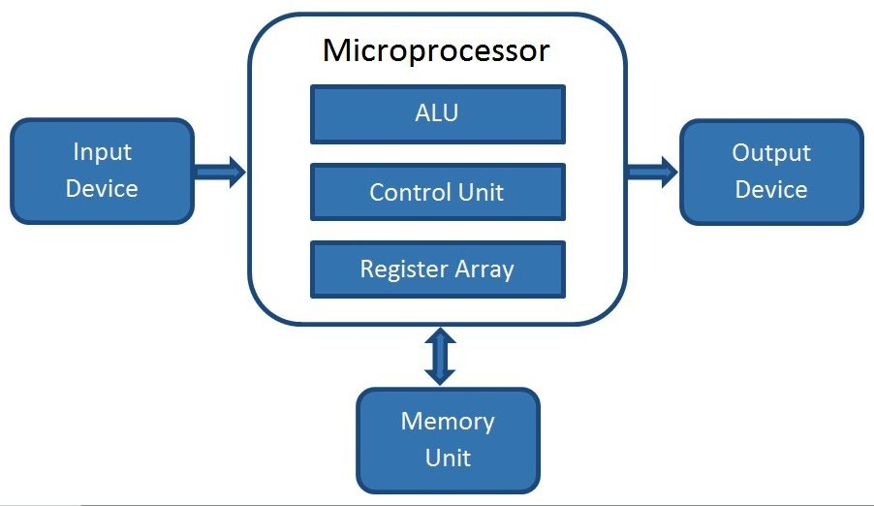
MICROPROCESSOR
A microprocessor is a processing unit(CPU) that is used to process the data like addition, subtraction etc.
It is a CPU on
a single chip.

Slide 37
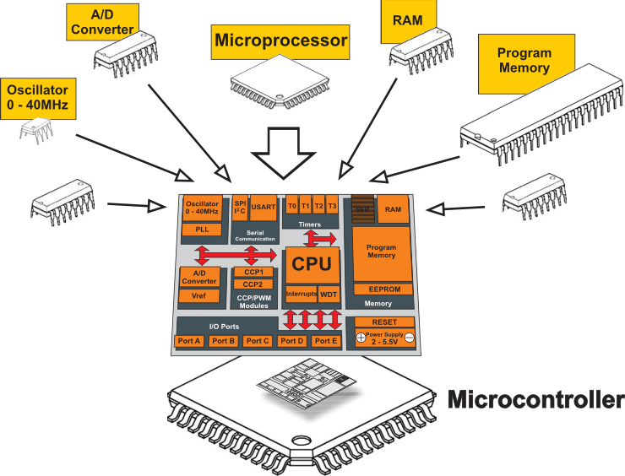
MICROCONTROLLERS
single integrated circuit intended
to operate as an embedded system.
Example: ATmega8

Slide 38
I/O Devies
Sensors
LEDS
MOTORS
SWITCHES
Every Sensor Will Have 3 Terminals..

Slide 39



MANUFACTURER
Major companies which manufacture microcontrollers:
ATMEL(AVR)
Microchip(PIC)
ARM

Slide 40
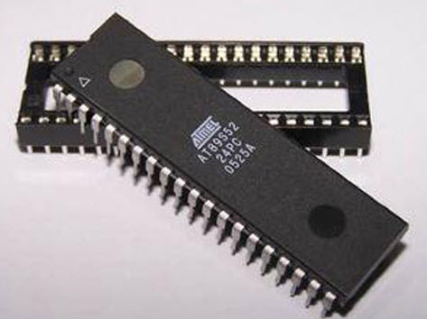
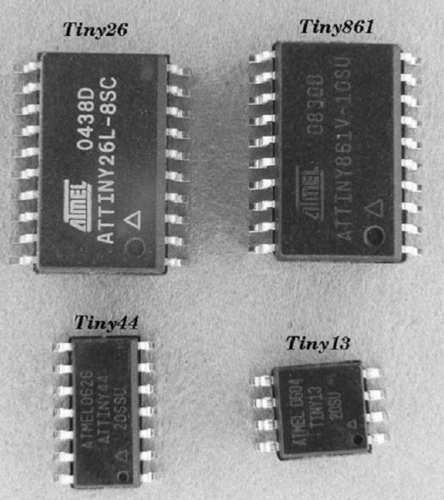
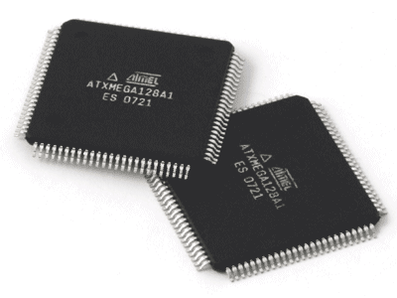
AVR Controllers
Mega
Tiny
Xmega

Slide 41
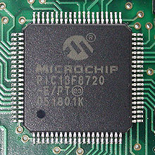
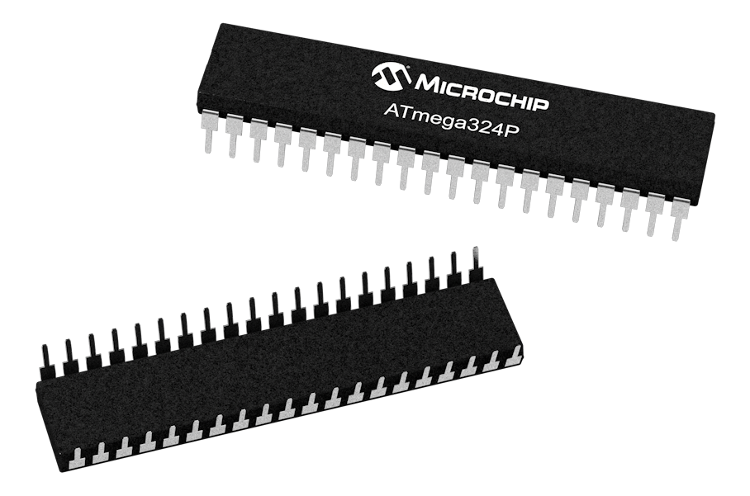
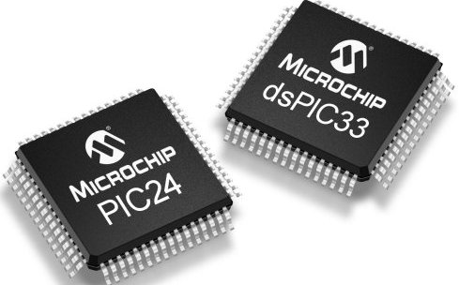
PIC Controllers

Slide 42
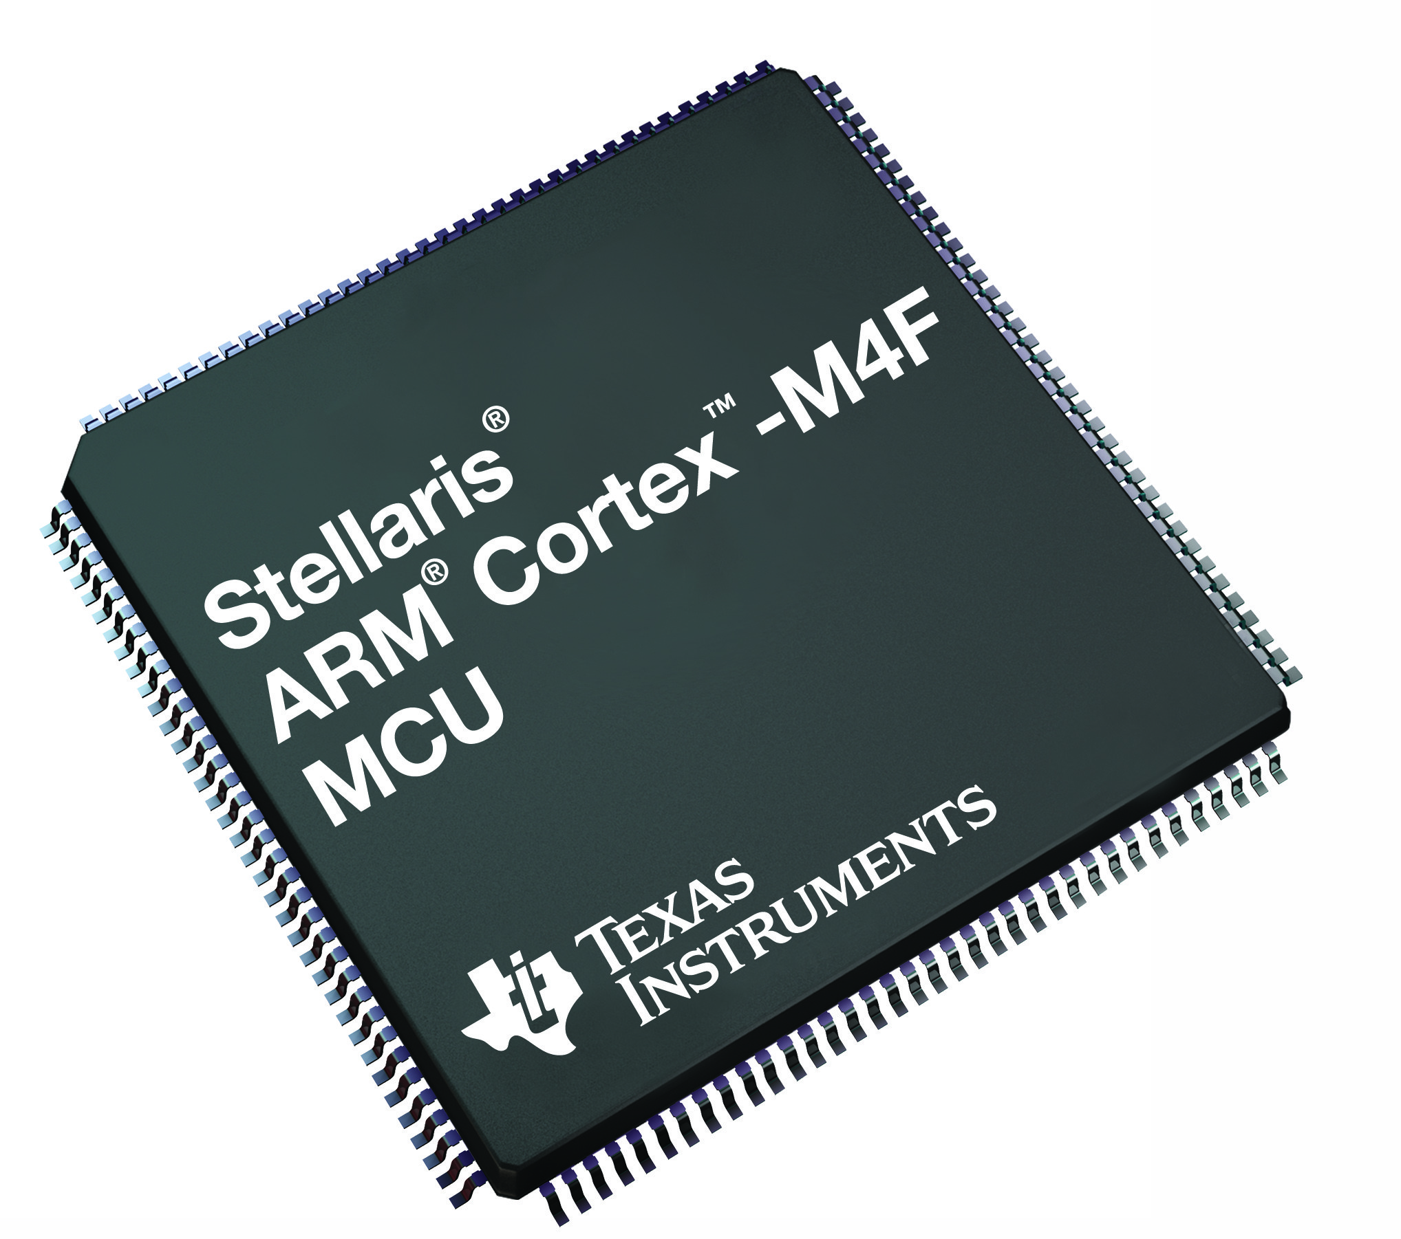
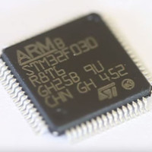
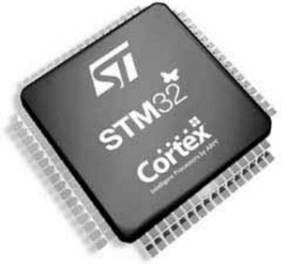
ARM Controllers

Slide 43
AVR Advanced Virtual RISC

Slide 44
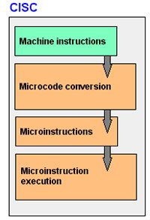
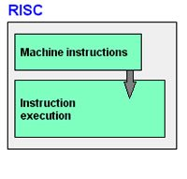
RISC AND CISC
RISC (Reduced instruction set computing)
CISC (Complex instruction set computing)

Slide 45
AVR Series of Microcontrollers
Xmega AVR
Tiny AVR
Mega AVR
AVR Series

Slide 46
AVR Microcontrollers
ATmega8 ATmega16 ATmega32
Here,
‘AT’ stands for the name of the company i.e. ATMEL
‘Mega’ stands for the mega series of AVR microcontrollers
8/16/32 stands for the Flash memory of the microcontroller

Slide 47
Continue…
Series Name | Pins | Flash Memory
Tiny AVR | 6-32 | 0.5-8 KB
Mega AVR | 28-100 | 4-256KB
Xmega AVR | 44-100 | 16-384KB
ATmega8

Slide 48
Continue…
Special Function registers
For accessing internal peripharals
ADC
SERIAL COM
PORTS

Slide 49
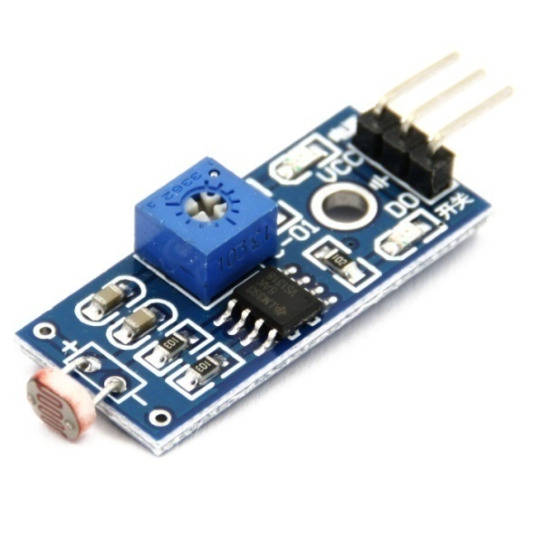
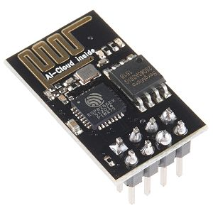
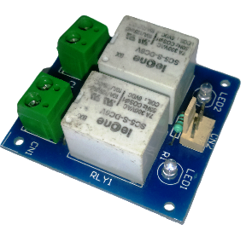
COMPONENTs
sensors
LDR sensor
ESP8266 Wi-Fi Module
Relay Module

Slide 50
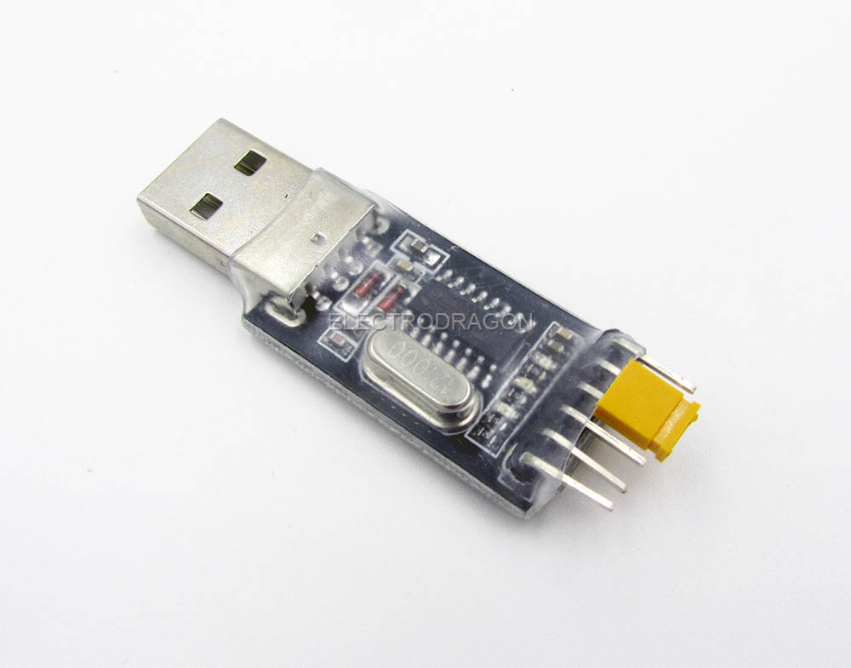
PICs of component used
USB to TTL converter:

Slide 51
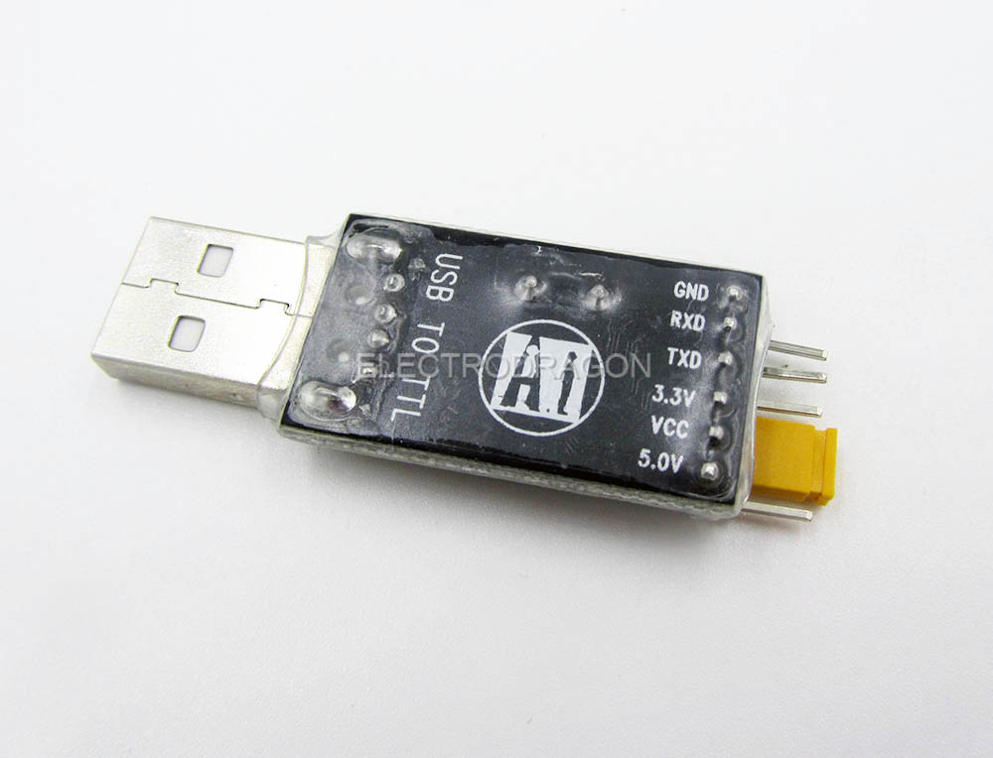
PICs of component used
USB to TTL converter:

Slide 52
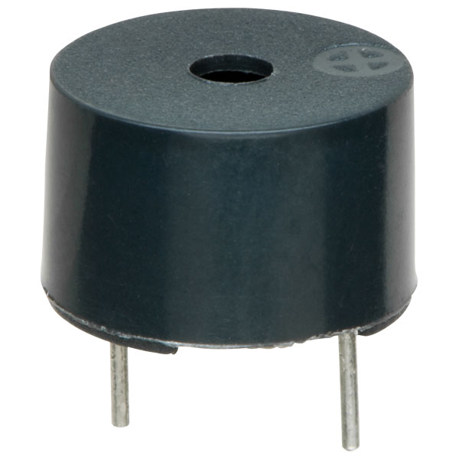
PICs of component used
Output device
Buzzer
16x2 LCD Display

Slide 53
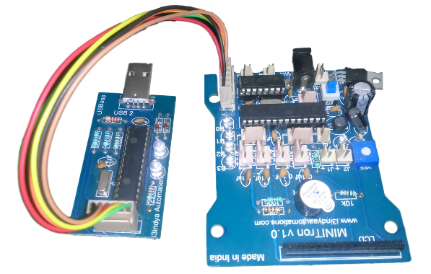
PICs of component used
Programmer & Board

Slide 54
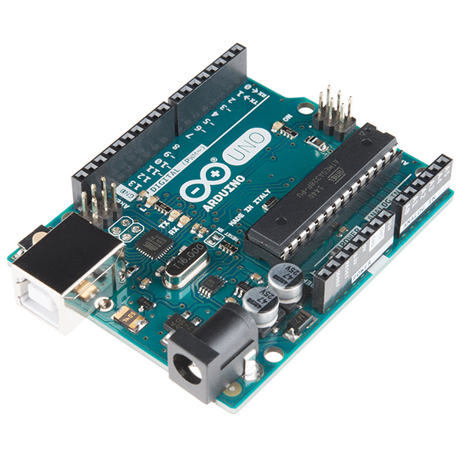
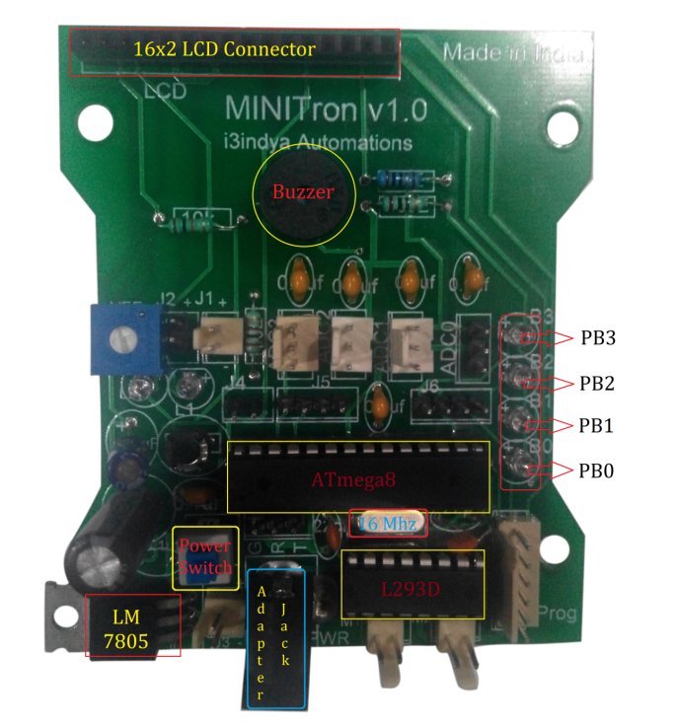
Difference between MINITron & Arduino uno
MINITron V1.0 | ARDUINO UNO

Slide 55
Difference between MINITron & Arduino uno
Features | MINITron | ARDUINO
CONTROLLER | ATMEGA8 | ATMEGA328
LCD | YES | NO
L293D(MOTOR IC) | YES | NO
LEDs | 4 LEDs | Only 1
ADC Sensor compatible connectors | YES | NO
Buzzer | YES | NO
Platform | NO | YES(0.5kb boot loader)

Slide 56
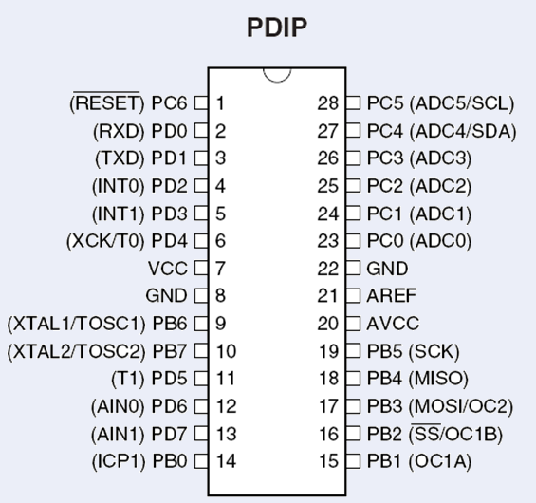
ATmega8

Slide 57
ATmega8 Specifications
8 KB of Flash memory
1KB of SRAM
512 Bytes of EEPROM
Available in 28-Pin DIP
6- Channel 10-bit ADC
Two 8-bit Timers/Counters
One 16-bit Timer/Counter
3 PWM Channels
In System Programmer (ISP)
Serial USART
SPI Interface
Digital to Analog Comparator.

Slide 58
Why we use Atmega 8 micro controller
8kb flash memory
Compact size
Low cost
Low power consumption
USART to communicate with ESP8266
ADC (Analog to Digital Converter)

Slide 59
I/O Operation
If any input or output device is to be connected to the microcontroller then it is connected to the I/O Ports. The ATmega8 has 3 I/O ports:
.
PORTB | 8
PORTC | 7
PORTD | 8
Total GPIO PINs | 23
CPU
There are three registers for I/O operations:
DDRX
PORTX
PINX
X can be ‘B’, ‘C’ or ‘D’ i.e. the I/O Ports.
Registers
Other Parts of the Microcontroller

Slide 60
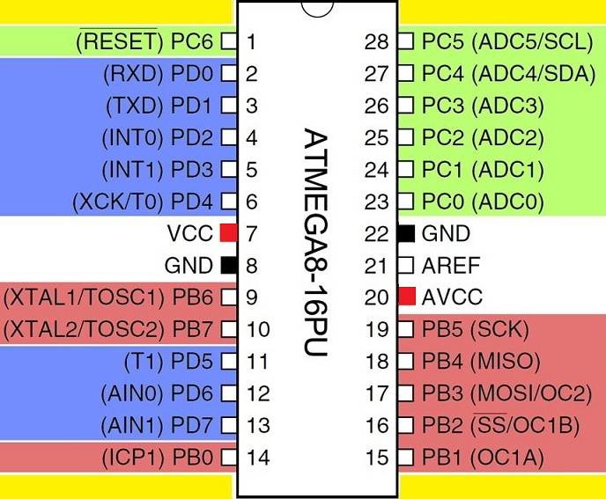
ATmega8

Slide 61
LED blinking

Slide 62
LED blinking
PD0
ATMEGA-8
PB0
PD1
PB1
PORTD
PD2
PB2
PORTB
PD3
PB3

Slide 63
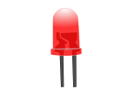
LED blinking
ATMEGA-8
PB0
PB1
PB2
Turn ON all led
PB3

Slide 64
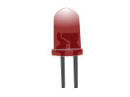
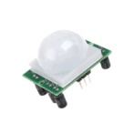

LED blinking
DDRB
Data direction register
Direction
ATMEGA-8
PB0
1
1
For OUTPUT
PB1
OUTPUT
Direction
To flow current out side from the controller
1
PB2
0
PB3
1

Slide 65
LED blinking
PORTB
PORT register
ATMEGA-8
PB0
1
1
PB1
This is To flow current out side from the controller
1
PB2
1
PB3

Slide 66
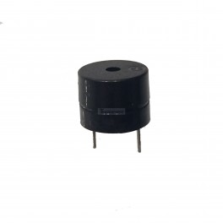
Direction for Buzzer
DDRD = 0b1111;
PD0
ATMEGA-8
PB0
1
PD1
1
PB1
PD2
1
PB2
PD3
1
PB3
Connected to PD2
Of PORTD

Slide 67

Buzzer ON
PORTD = 0b0100;
PD0
ATMEGA-8
PB0
0
PD1
0
PB1
PD2
1
PB2
PD3
0
PB3
Connected to PD2
Of PORTD

Slide 68
LED blinking
PD0
ATMEGA-8
PB0
PD1
PB1
PORTD
PD2
PB2
PD3
PB3

Slide 69
For Example:
If we want to make a complete port as output port, then we write :
DDRX=0b11111111
If we want to make a complete port as input port, then we write :
DDRX=0b00000000
If we want to make 7^{th,} 4th and 3rd pin as output and rest of the pins as input, then we write:
DDRX=0b10011000 ;
1 | 1 | 1 | 1 | 1 | 1 | 1 | 1
0 | 0 | 0 | 0 | 0 | 0 | 0 | 0

Slide 70
For Example:
If we want to make a complete port as output port, then we write :
DDRX=0b11111111
If we want to make a complete port as input port, then we write :
DDRX=0b00000000
If we want to make 7^{th,} 4th and 3rd pin as output and rest of the pins as input, then we write:
DDRX=0b10011000 ;
1 | 1 | 1 | 1 | 1 | 1 | 1 | 1
0 | 0 | 0 | 0 | 0 | 0 | 0 | 0

Slide 71
For Example:
If we want to make a complete port as output port, then we write :
DDRX=0b11111111
If we want to make a complete port as input port, then we write :
DDRX=0b00000000
If we want to make 7^{th,} 4th and 3rd pin as output and rest of the pins as input, then we write:
DDRX=0b10011000 ;
1 | 1 | 1 | 1 | 1 | 1 | 1 | 1
0 | 0 | 0 | 0 | 0 | 0 | 0 | 0

Slide 72
PORTX…
Till now we have just decided that whether our port is output or input.
Lets say we made our PORTB as output by writing DDRB=0b11111111.
Now what voltage levels the port should output, depends upon the PORTX register.
PORTX register is also of 8 bit size.
PORTX
7 | 6 | 5 | 4 | 3 | 2 | 1 | 0
If we want, 7th and 4th pin of the PORTB should output 5V and rest of the pins should
Output 0V, then we write:
PORTB=0b10010000

Slide 73
Windows 10: Disable Signed Driver Enforcement
Click the Start menu and select Settings.
Click Update and Security.
Click on Recovery.
Click Restart now under Advanced Startup.
Click Troubleshoot.
Click Advanced options.
Click Startup Settings.
Click on Restart.
On the Startup Settings screen press 7 or F7 to disable driver signature enforcement.

Slide 74

DISABLE DRIVER SIGNATURE ENFORCEMENT

Slide 75

DISABLE DRIVER SIGNATURE ENFORCEMENT

Slide 76

DISABLE DRIVER SIGNATURE ENFORCEMENT

Slide 77

DISABLE DRIVER SIGNATURE ENFORCEMENT

Slide 78

DISABLE DRIVER SIGNATURE ENFORCEMENT

Slide 79

DISABLE DRIVER SIGNATURE ENFORCEMENT

Slide 80

DISABLE DRIVER SIGNATURE ENFORCEMENT

Slide 81


Getting Started with AVR Studio
Insert the CD provided to you in CD-ROM
Go to:
Install ‘WinAVR’
Install ‘avrstudio4’

Slide 82

Click on
Go to AVR Atmel tools
AVR Studio 4

Slide 83



New Project.
AVR GCC
Name of the project

Slide 84

3
1
2

Slide 85



4.
Select AVR Simulator
5.
Device Selection (AT mega16)
6.
Finish

Slide 86


Editor Window: Writing your Program here.

Slide 87
Interfacing LED with At mega8
#include<avr/io.h>
#include<util/delay.h>
void main()
{
DDRB=0B11111111;
while(1)
{ PORTB=0B11111111;
_delay_ms(1000);
PORTB=0B00000000;
_delay_ms(1000);
}
}

Slide 88


Slide 89




Update the Driver

Slide 90




Steps to Burn the program.
1
3
2
4
5

Slide 91

LED Exercises…
Glow a single LED.
Blink a single LED.
Glow all 4 LEDs
Blink all 4 LEDs
Blink even and odd LEDs

Slide 92


RELAY
A relay is a simple electromechanical switch made up of an electromagnet
and a set of contacts.
Electromagnet
Armature that can be attracted by the electromagnet
Spring
Set of electrical contacts

Slide 93

RELAY connections

Slide 94

ADC Theory
ADC : Analog to digital converter.
>> to sense the environment.
• 10-bit Resolution (8-bit Accuracy on ADC4 and ADC5).
• 65 - 260 μs Conversion Time
• Selectable 2.56V ADC Reference Voltage.

Slide 95


LDR Light dependent resistors come in different shapes and colors. LDRs are very useful in many electronic circuits, especially in alarms, switching devices, clocks, street lights and more. It is used to turn ON or OFF a device according to the ambient light.

Slide 96

LDR Light dependent resistors come in different shapes and colors. LDRs are very useful in many electronic circuits, especially in alarms, switching devices, clocks, street lights and more. It is used to turn ON or OFF a device according to the ambient light.

Slide 97

LDR Light dependent resistors come in different shapes and colors. LDRs are very useful in many electronic circuits, especially in alarms, switching devices, clocks, street lights and more. It is used to turn ON or OFF a device according to the ambient light.

Slide 98
ADC
7 | 6 | 5 | 4 | 3 | 2 | 1 | 0
ADCSRA → PORTA
ADMUX → PORTB
PB7 | PB6 | PB5 | PB4 | PB3 | PB2 | PB1 | PB0

Slide 99

ADC
7 | 6 | 5 | 4 | 3 | 2 | 1 | 0
ADCSRA
ADMUX
ADEN | ADSC | ADATE | ADIF | ADIE | ADPS2 | ADPS1 | ADPS0

Slide 100

ADC
7 | 6 | 5 | 4 | 3 | 2 | 1 | 0
ADCSRA
ADMUX
REFS1 | REFS0 | ADLAR | MUX4 | MUX3 | MUX2 | MUX1 | MUX0

Slide 101

Serial v/s Parallel communication

Slide 102
Serial communication in AVR
USART
AVR microcontrollers have a dedicated hardware for serial communication; this part is called Universal Synchronous Asynchronous Receiver and Transmitter (USART).
You just have to supply the data to transmit and it will do the rest.
The data to be transmitted is written to one of the register of USART and USART transmits it.
Also USART automatically senses the transmission of RX line and then inputs the whole Byte and when it has the byte it informs the CPU to read the data from one of its registers.

Slide 103
USART
7 | 6 | 5 | 4 | 3 | 2 | 1 | 0
UCSRA → PORTA
UCSRB → PORTB
UCSRC → PORTC
UBRRL
UDR
PB7 | PB6 | PB5 | PB4 | PB3 | PB2 | PB1 | PB0

Slide 104
USART
7 | 6 | 5 | 4 | 3 | 2 | 1 | 0
UCSRA
UCSRB
UCSRC
UBRRL
UDR
While(!(UCSRA&(1<<RXC)));
‘A’
0x41 = 0b01000001
While(!(UCSRA&(1<<udre)));
0
1
0
0
0
0
0
1
RCX | TXC | UDRE | FE | DOR | PE | U2X | MPCM

Slide 105
USART
7 | 6 | 5 | 4 | 3 | 2 | 1 | 0
UCSRA
UCSRB
UCSRC
UBRRL
UDR
RXCIE | TXCIE | UDRIE | RXEN | TXEN | UCSZ2 | RXB8 | TXB8

Slide 106

USART
7 | 6 | 5 | 4 | 3 | 2 | 1 | 0
UCSRA
UCSRB
UCSRC
UBRRL
UDR
URSEL | UMSEL | UPM1 | UPM0 | USBS | UCSZ1 | UCSZ0 | UCPOL

Slide 107


USART
7 | 6 | 5 | 4 | 3 | 2 | 1 | 0
UCSRA
UCSRB
UCSRC
UBRRL
UDR
7 | 6 | 5 | 4 | 3 | 2 | 1 | 0

Slide 108
USART
7 | 6 | 5 | 4 | 3 | 2 | 1 | 0
UCSRA
UCSRB
UCSRC
UBRRL
UDR
‘A’
7 | 6 | 5 | 4 | 3 | 2 | 1 | 0

Slide 109
Baud Rate and Bit Rate
Baud rate is the number of signal change in one second.
Bit Rate is the number of data bits transmitted in one second.
Both of them has the same unit ‘bits/second’.
Baud rate is determined by the number of bits in one frame while bit rate is determined by the number of data its in that frame.
Atmega16 support five different data sizes 5,6,7,8 and 9 bits.

Slide 110

RS232
In Rs 232 there are two data lines RX and TX.
TX to Transmit the data.
RX to Receive the data.
We know that a
HIGH = +5V and LOW= 0V in TTL/MCU
HIGH= -12V and LOW =+12V. RS232
So we need line driver IC MAX232.

Slide 111

Connection with AVR

Slide 112
Exercises to do
→ LED blinking.(through keyboard.)
PC control LED.(wired)

Slide 113
ESP8266(WIFI module)
The ESP8266 is a low-cost Wi-Fi chip with full TCP/IP stack and MCU (microcontroller unit) capability produced by Shanghai-based Chinese manufacturer ,Espressif Systems.

Slide 114
PIN DESCRIPTION
Vcc: 3.3V, up to 300 mA
GND: Ground
Tx: UART Tx of the module, to be connected to the Rx of the microcontroller
Rx: UART Rx of the module, to be connected to the Tx of the microcontroller
RST: Reset/Restart, pull to GND to restart
CH_PD: Chip enable, used for flash boot .
GPIO0: pulled low for update mode
GPIO2: ---

Slide 115
Things required for project
USB asp programmer
MINITron board
Connectors
LDR Sensor
RELAY Module
Wi-Fi Module
3.3v Power supply
Atmel studio software for coding
USB asp driver software
Burner software (Avr loader software)

Slide 116
i3indya Group of Companies:
i3indya Technologies
i3indya Cyber Solutions
i3indya Automations
i3indya Web Solutions
i3indya E-shop
i3indya Publications
www.i3indya.com

